Slide 1
Home Page
Please submit your feedback using the on-line form. Thankyou.
https://online1.snapsurveys.com/phasetwo

Slide 2
CYP Page
Please submit your feedback using the on-line form. Thankyou.
https://online1.snapsurveys.com/phasetwo

Slide 3
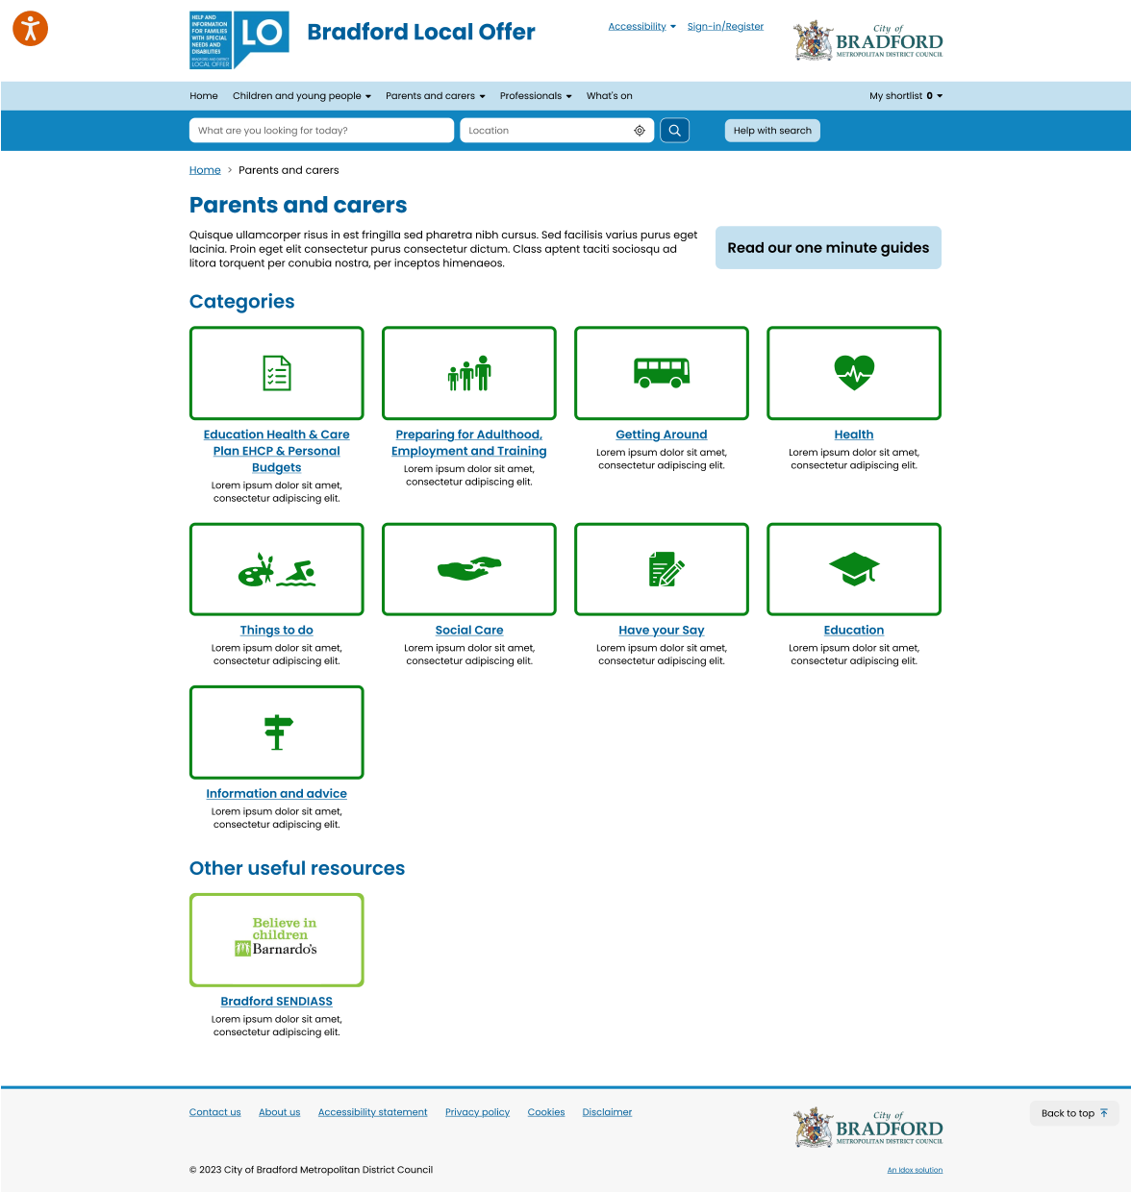
Parent / Carers Page
Please submit your feedback using the on-line form. Thankyou.
https://online1.snapsurveys.com/phasetwo

Slide 4
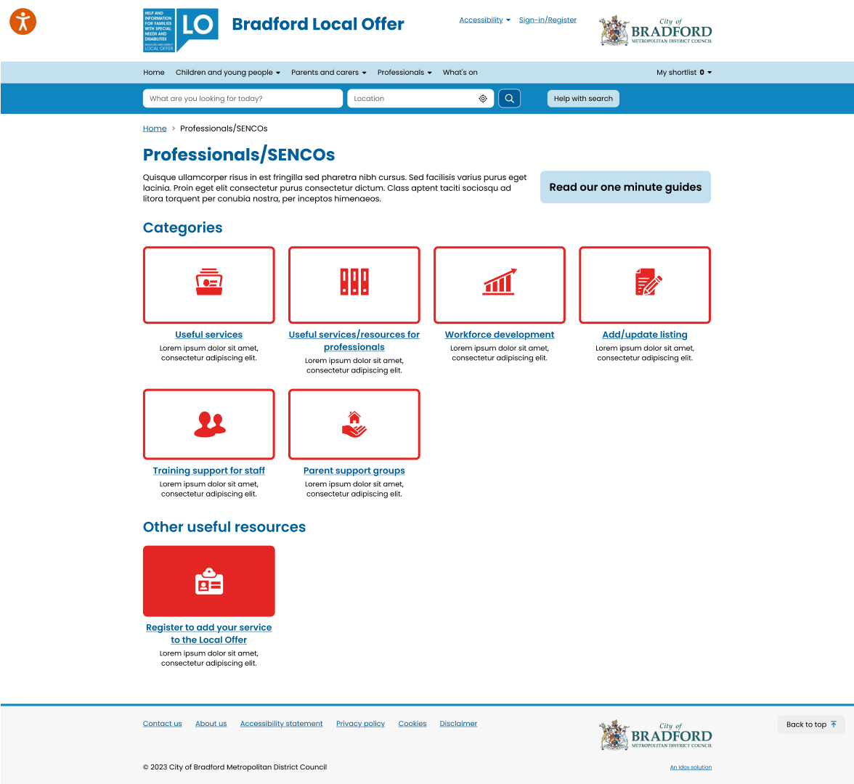
Professionals Page
Please submit your feedback using the on-line form. Thankyou.
https://online1.snapsurveys.com/phasetwo

Slide 5
Categories Page
Please submit your feedback using the on-line form. Thankyou.
https://online1.snapsurveys.com/phasetwo

Slide 6
Information Page
Please submit your feedback using the on-line form. Thankyou.
https://online1.snapsurveys.com/phasetwo

Slide 7
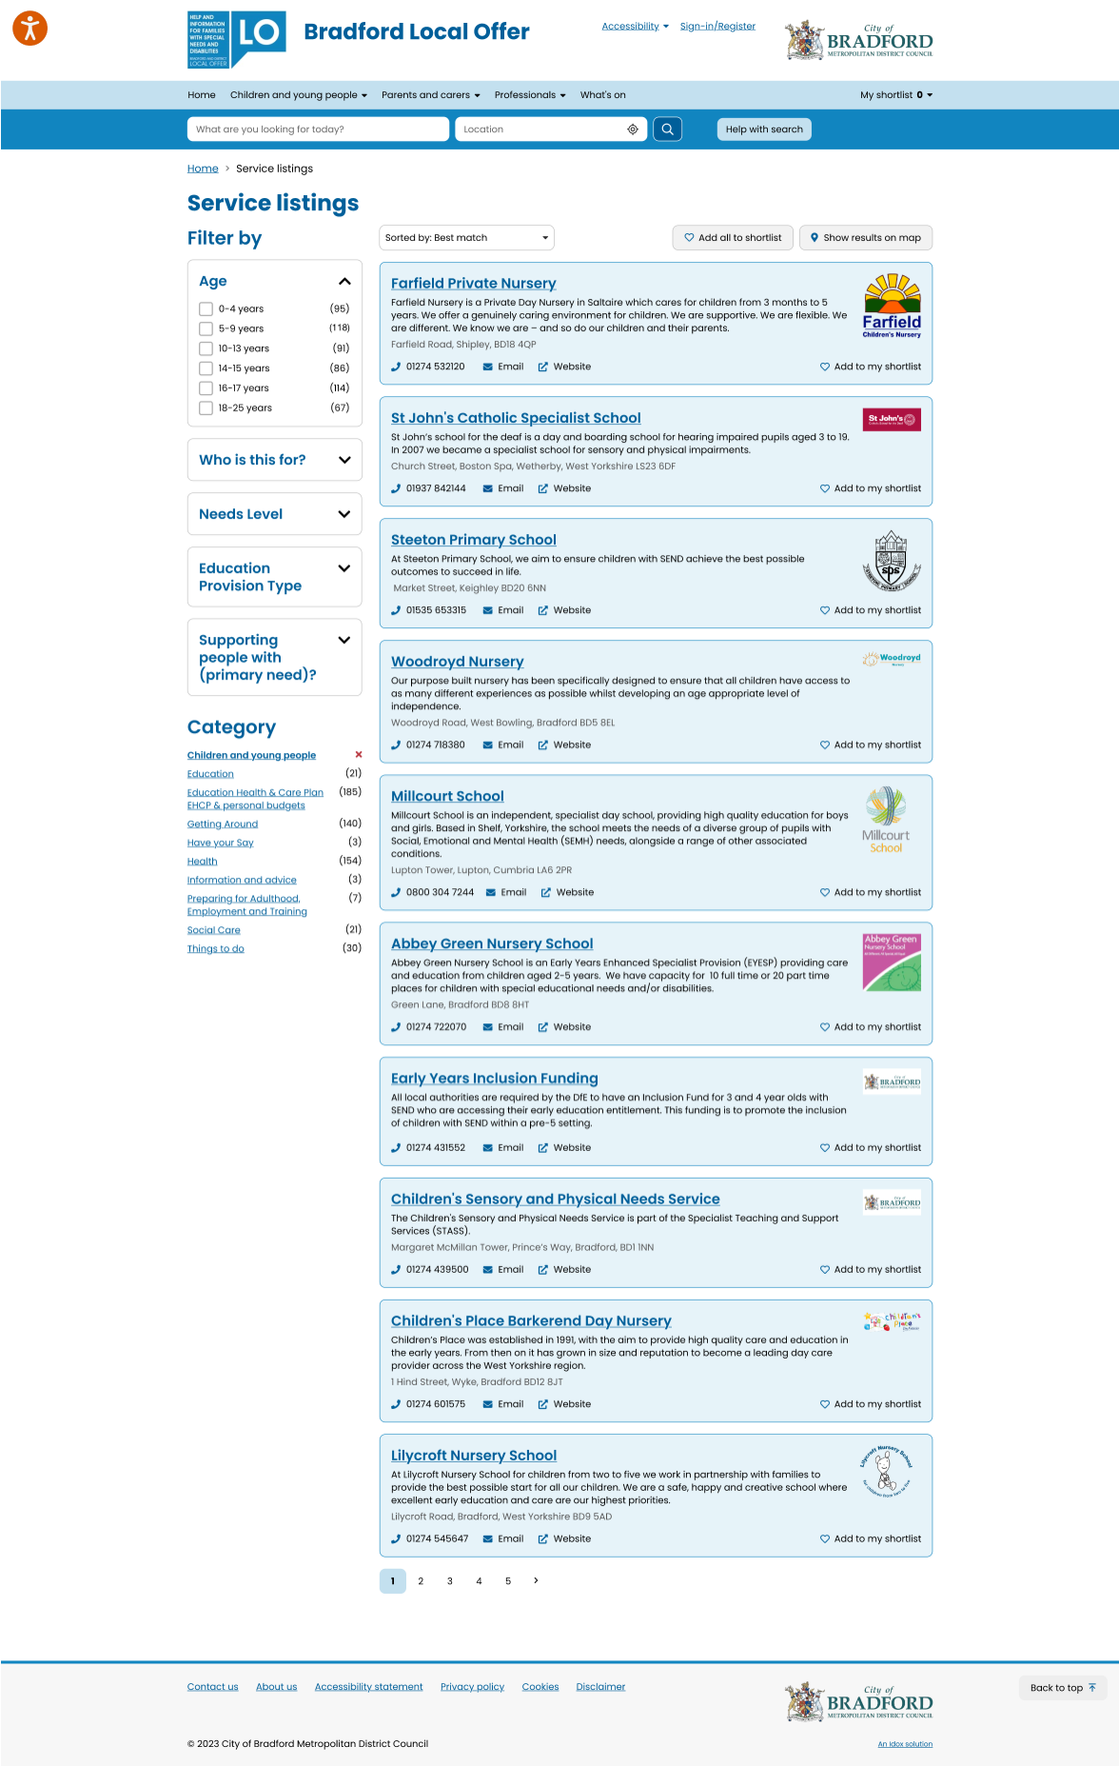
Listings Page
Please submit your feedback using the on-line form. Thankyou.
https://online1.snapsurveys.com/phasetwo

Slide 8
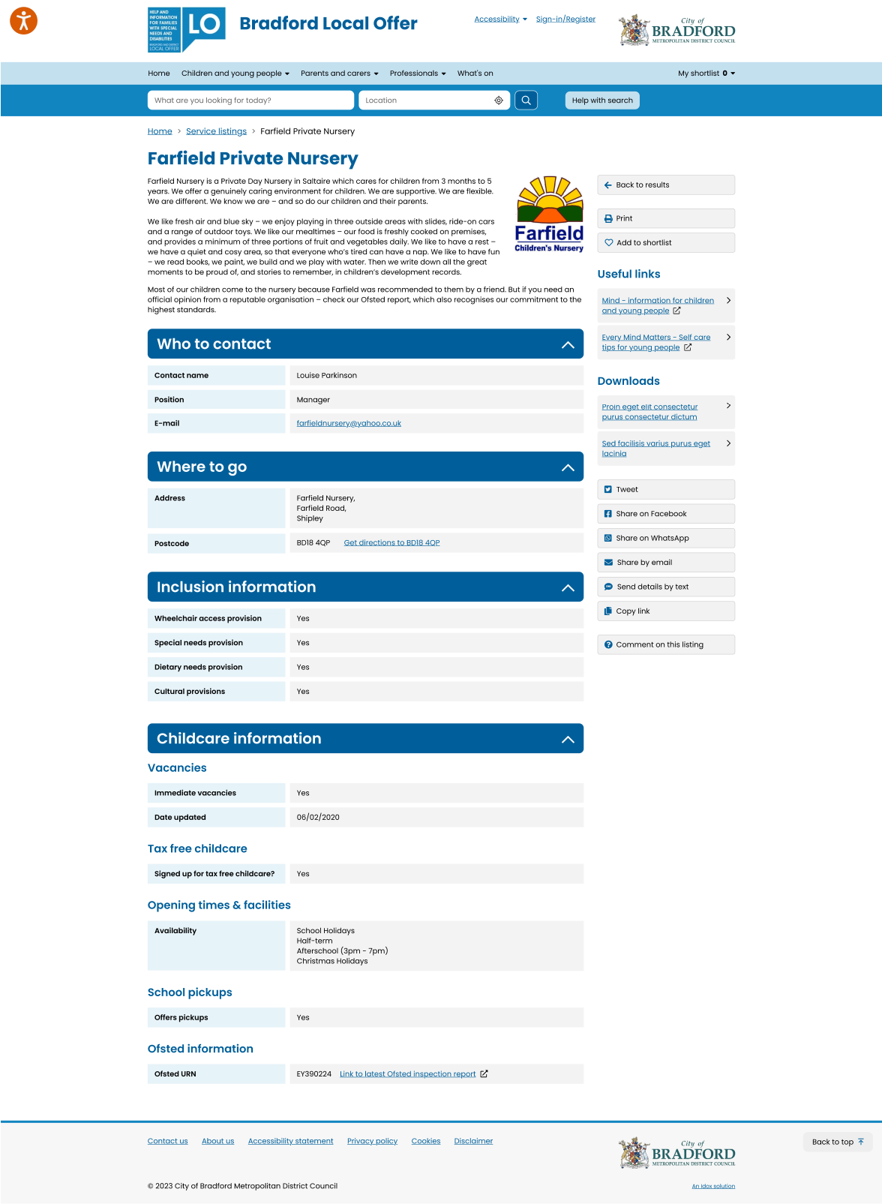
Service Page
Please submit your feedback using the on-line form. Thankyou.
https://online1.snapsurveys.com/phasetwo

Slide 9
Mobile Pages
Please submit your feedback using the on-line form. Thankyou.
https://online1.snapsurveys.com/phasetwo

